Slide 1
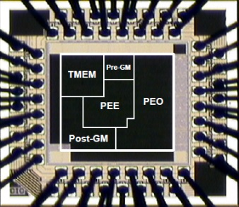
Lab05-FPGA Flow (I)
Song-Nien Tang
Department of Information & Computer Engineering
Chung Yuan Christian University
sntang@ice.cycu.edu.tw

Slide 2
Altera FPGA Design Flow
Design RTL code (.v)
Find device type
Use Quartus-II tools
Synthesis
Implement Design
Generate bit-stream
Configure Target Device
Use ModelSim-Altera
Post-Simulation
使用先前的Counter.v (Lab03或Lab04皆可)

Slide 3
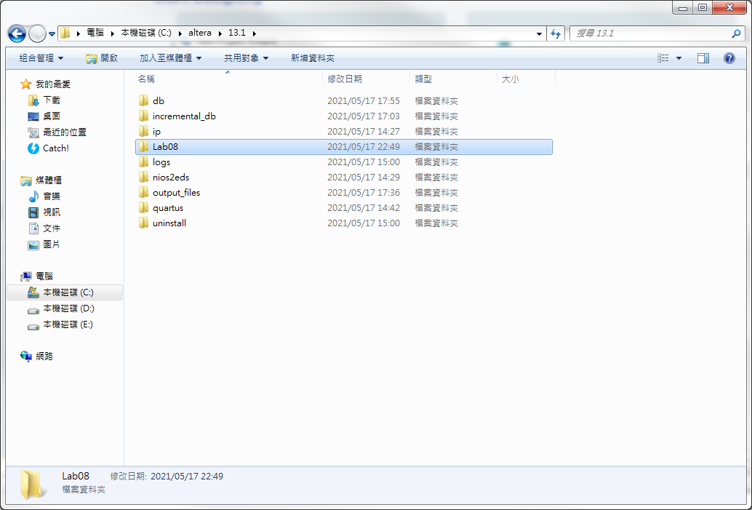
New Project
先建立好Quartus Project執行的”工作目錄”
(此處為一個例子)

Slide 4
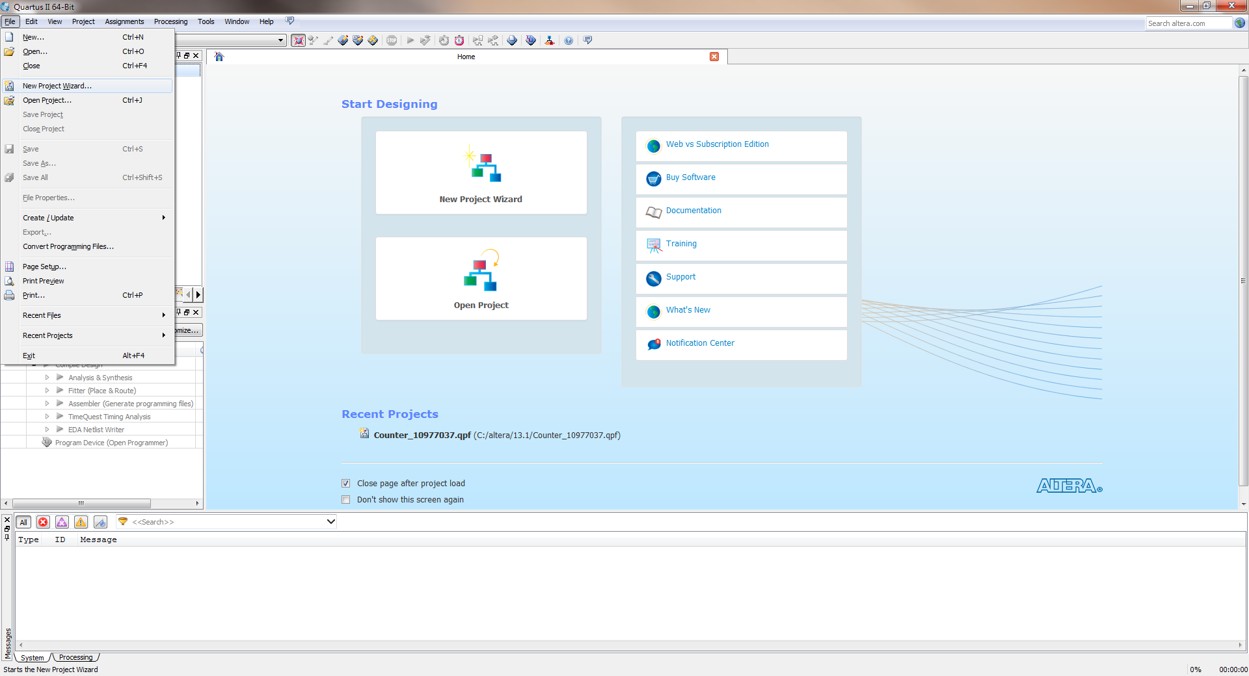
New Project
Creat a New Project

Slide 5
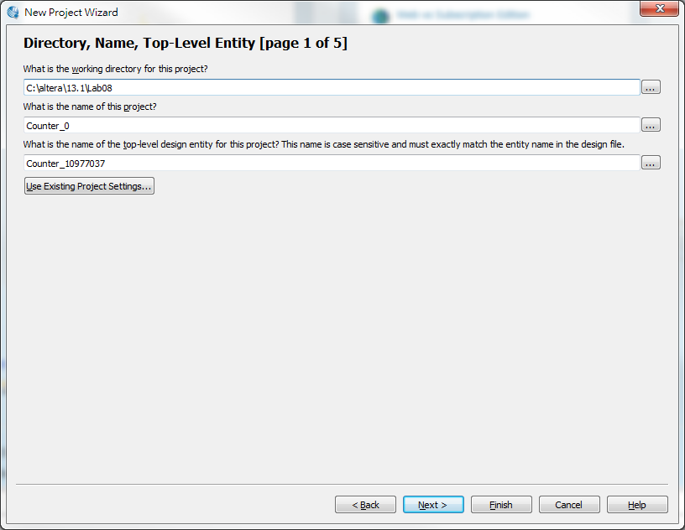
New Project
選取剛剛新建的工作目錄
Key in project name
兩者名稱可不同
方式1: Counter_組別
或方式2: Counter_學號
注意: 此處為設計Top Module名稱(各組自訂)

Slide 6
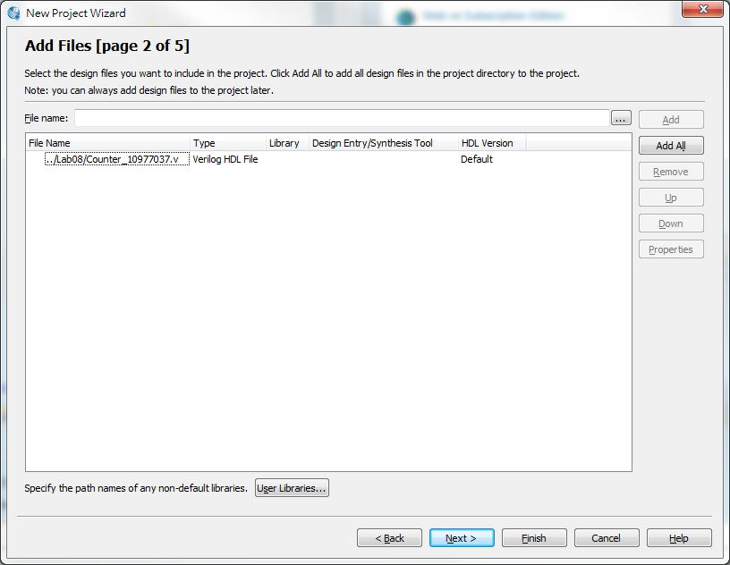
Project Settings

Slide 7
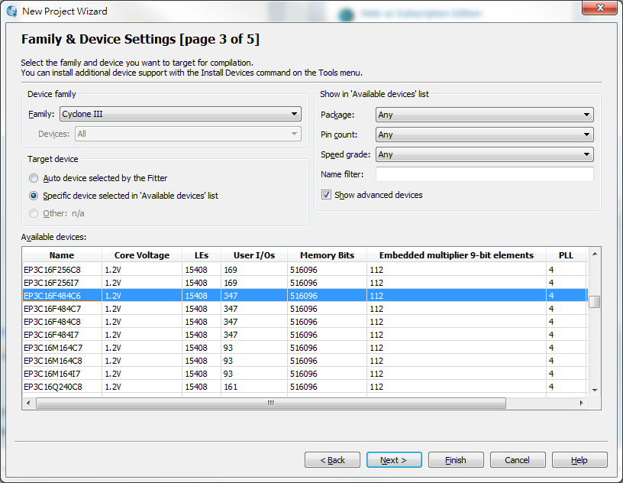
Project Settings

Slide 8
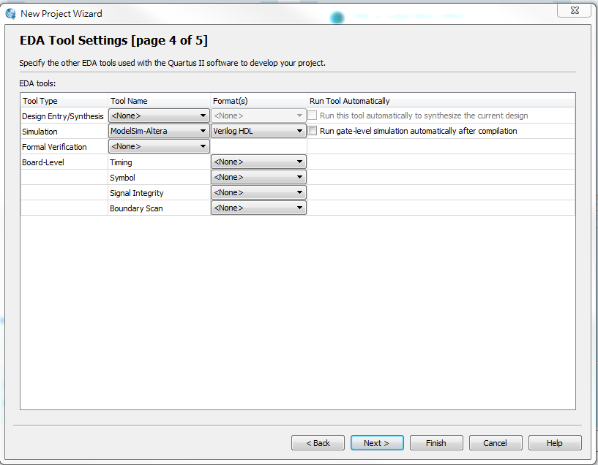
Project Settings
1
2

Slide 9
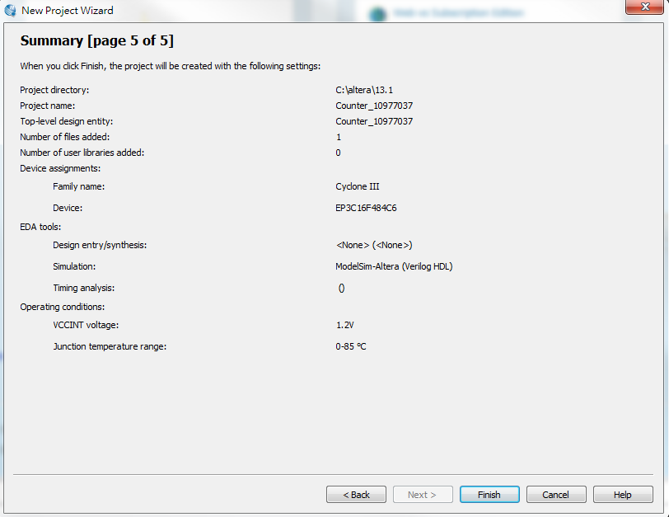
Project Summary

Slide 10
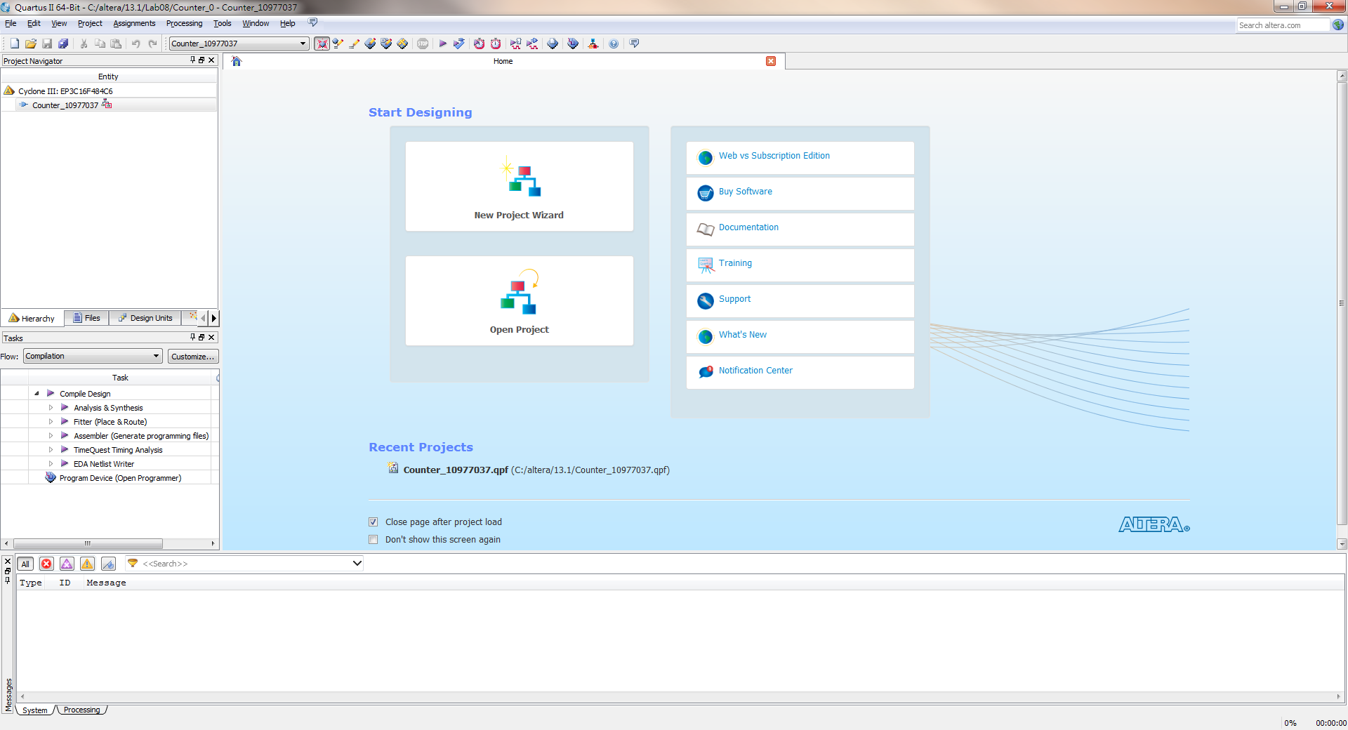
GUI Window
會出現你設的”Project Name”

Slide 11
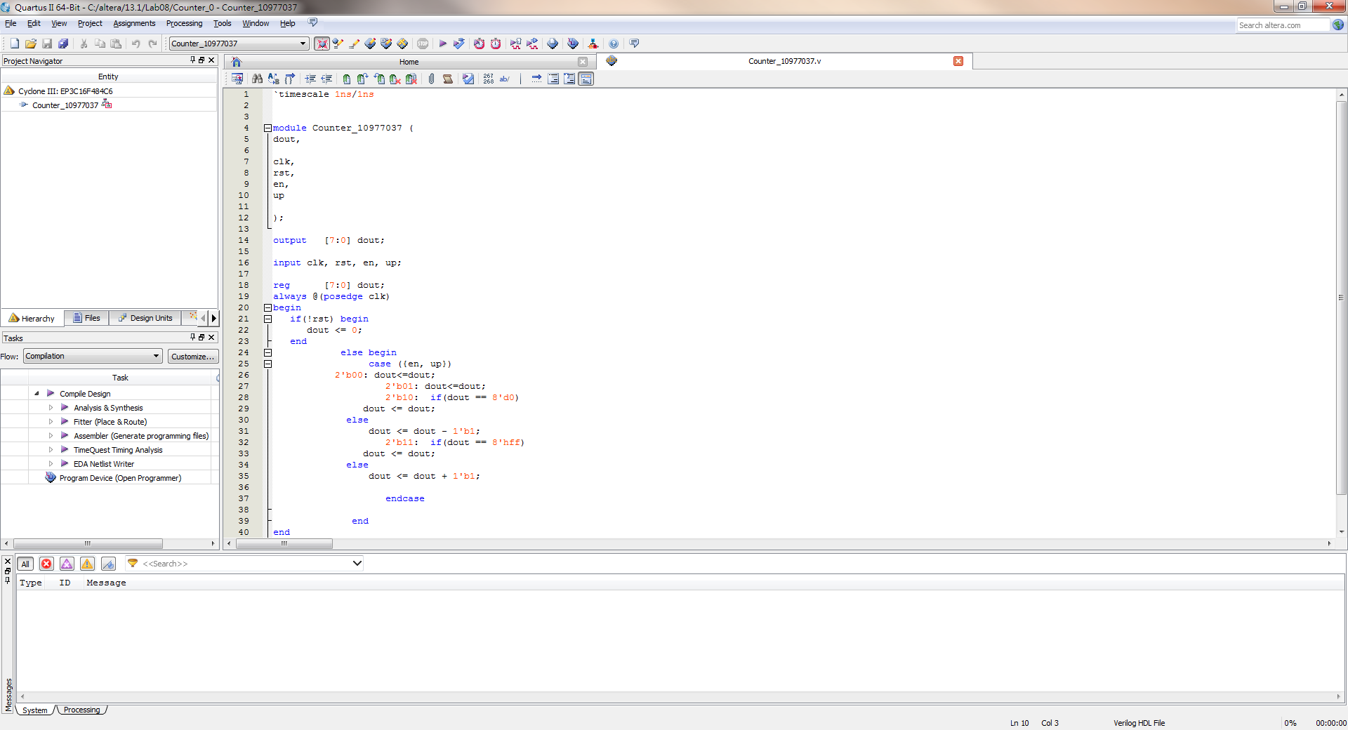
Verilog code

Slide 12
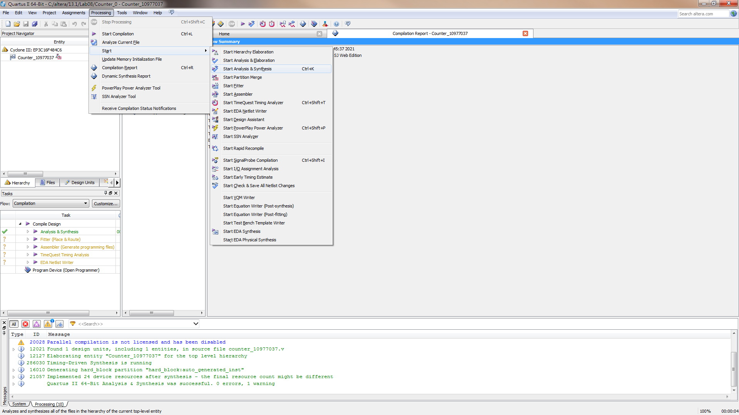
Run Synthesis

Slide 13
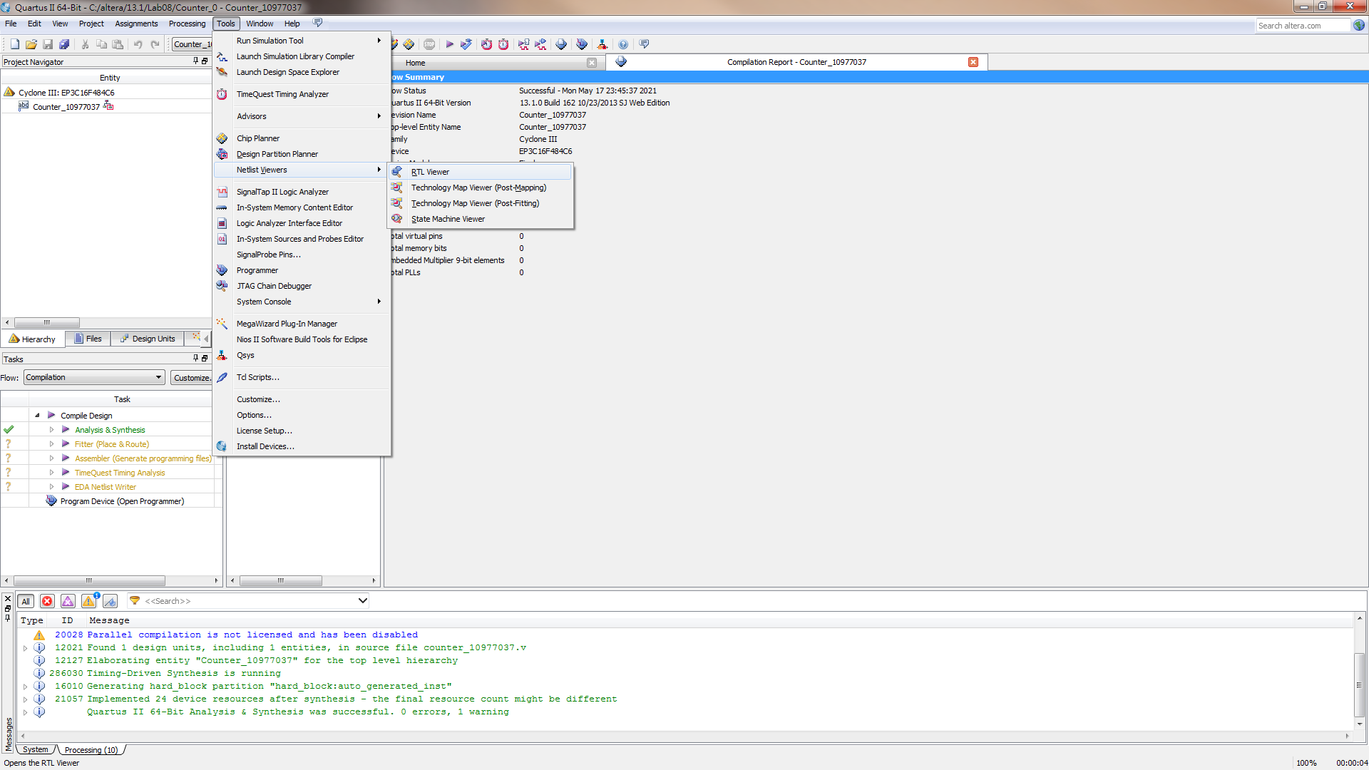
View Schematics

Slide 14
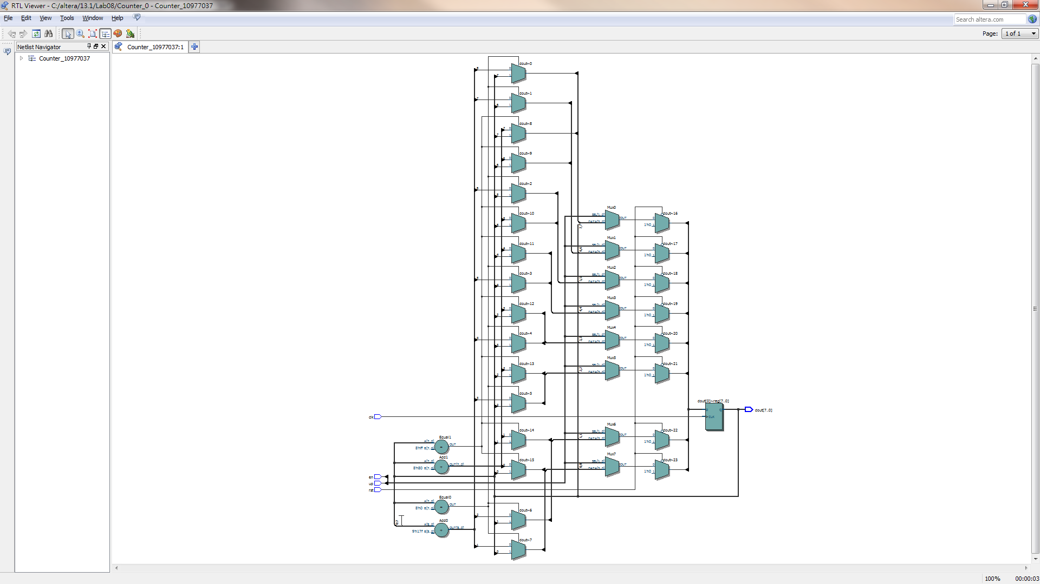
View RTL Schematic
截圖1 !

Slide 15
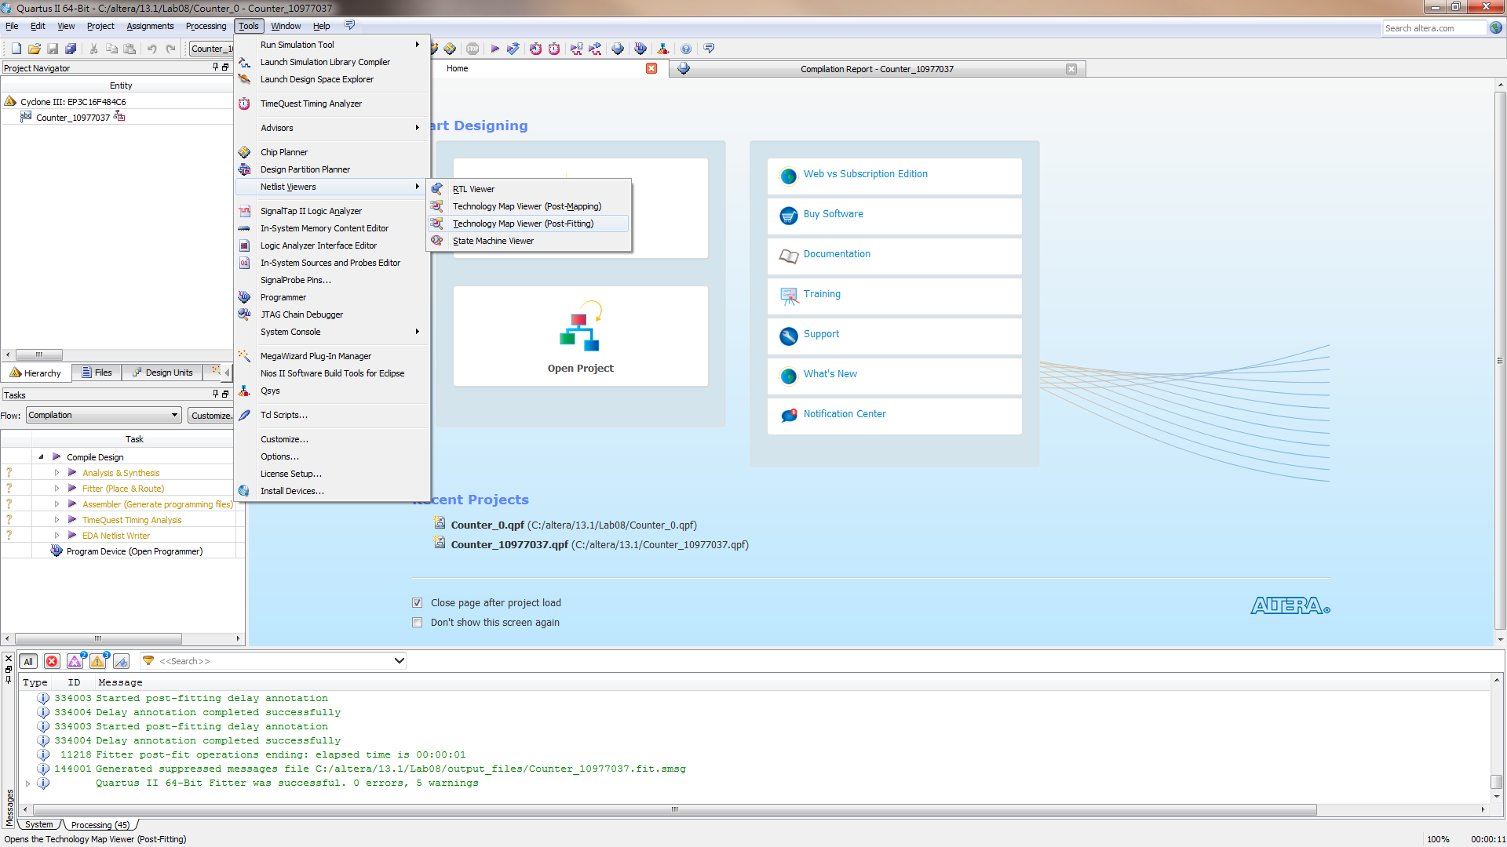
View Technology Schematic

Slide 16
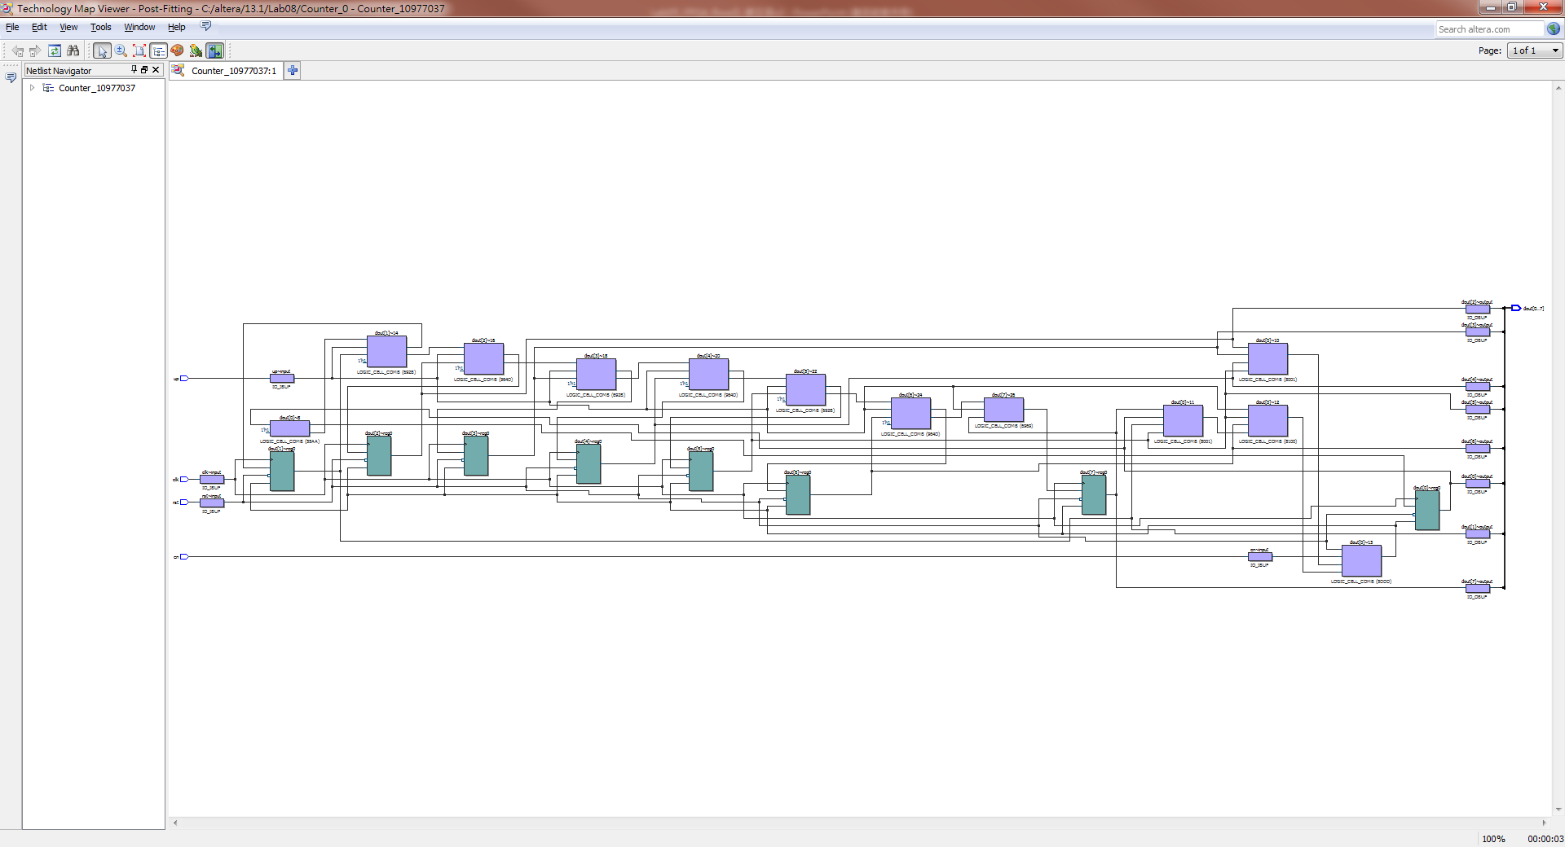
View Technology Schematic
截圖2 !

Slide 17
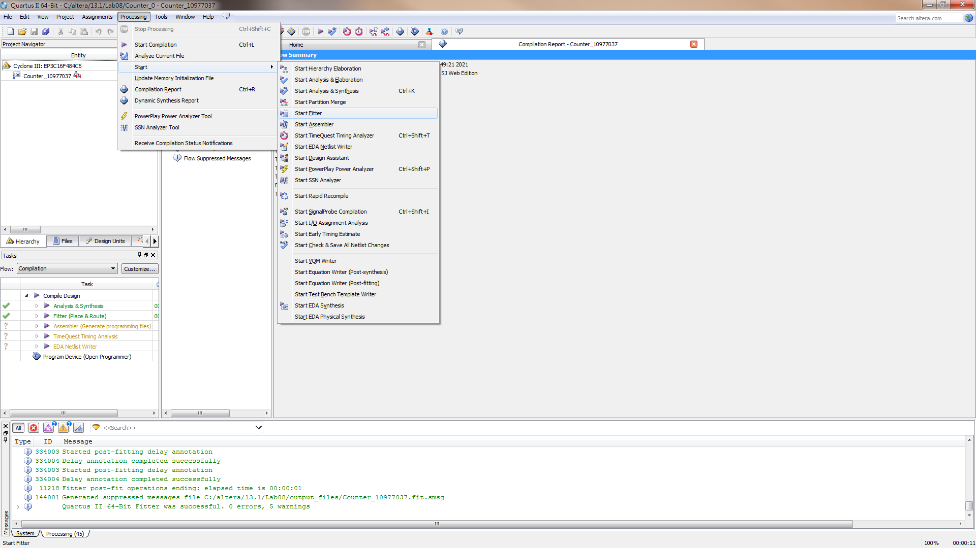
Run Fitter

Slide 18
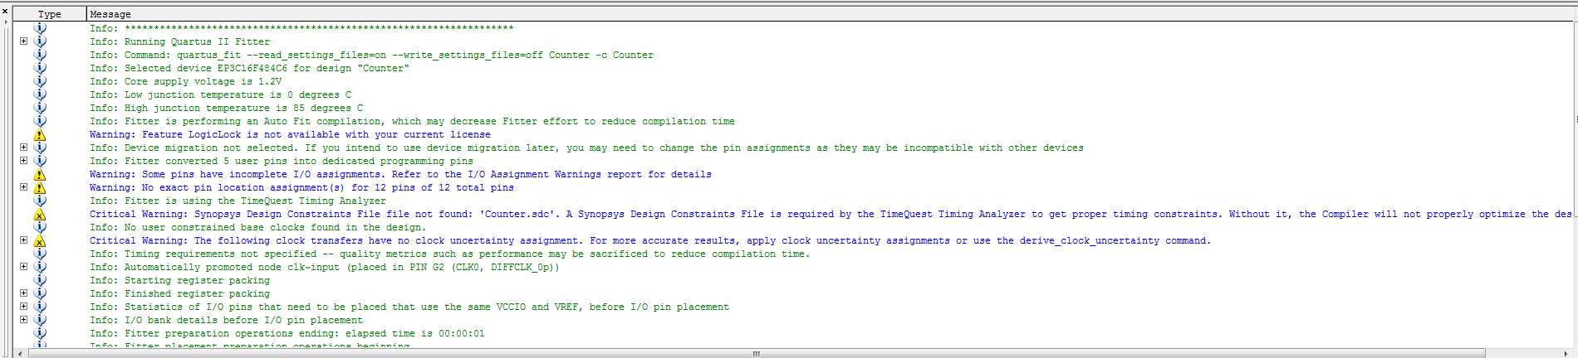
Run Fitter (Warning)

Slide 19
Altera FPGA Design Flow
Design RTL code (.v)
Find device type
Use Quartus-II tools
Synthesize
Implement Design
Constraint assignment
Pin assignment
Generate bit-stream
Configure Target Device
Use ModelSim-Altera
Post-Simulation

Slide 20
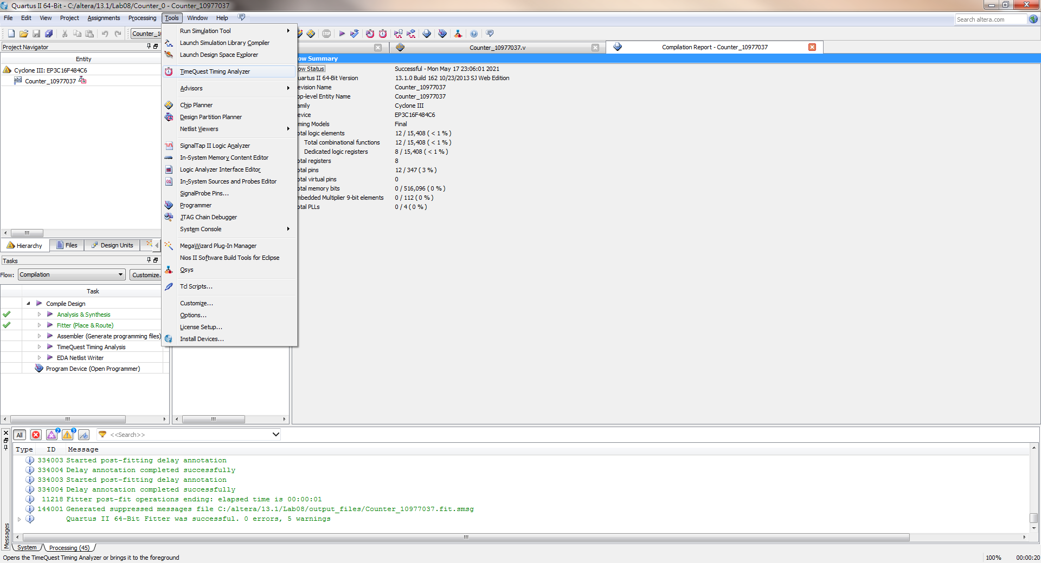
Constraints assignment

Slide 21
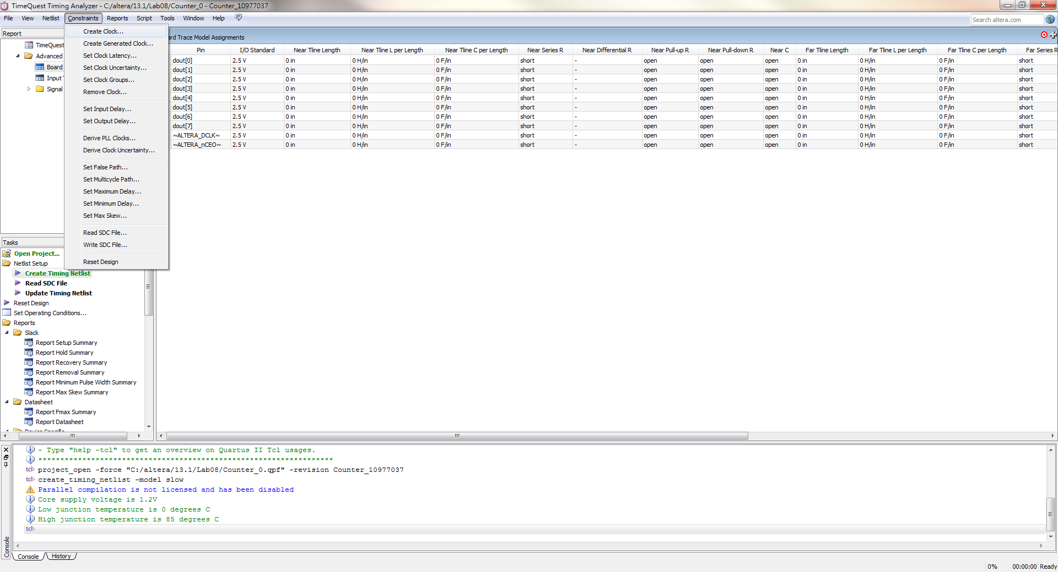
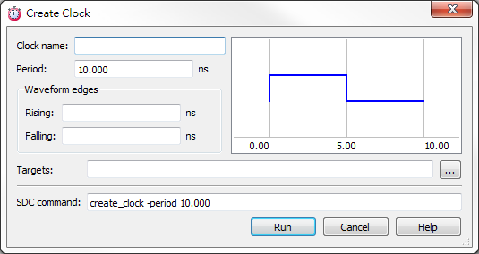
Constraints assignment
先點選此item!

Slide 22
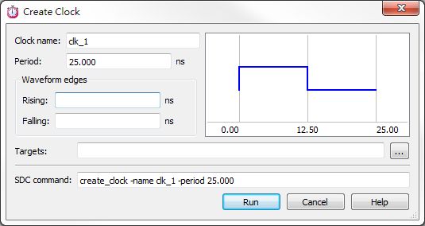
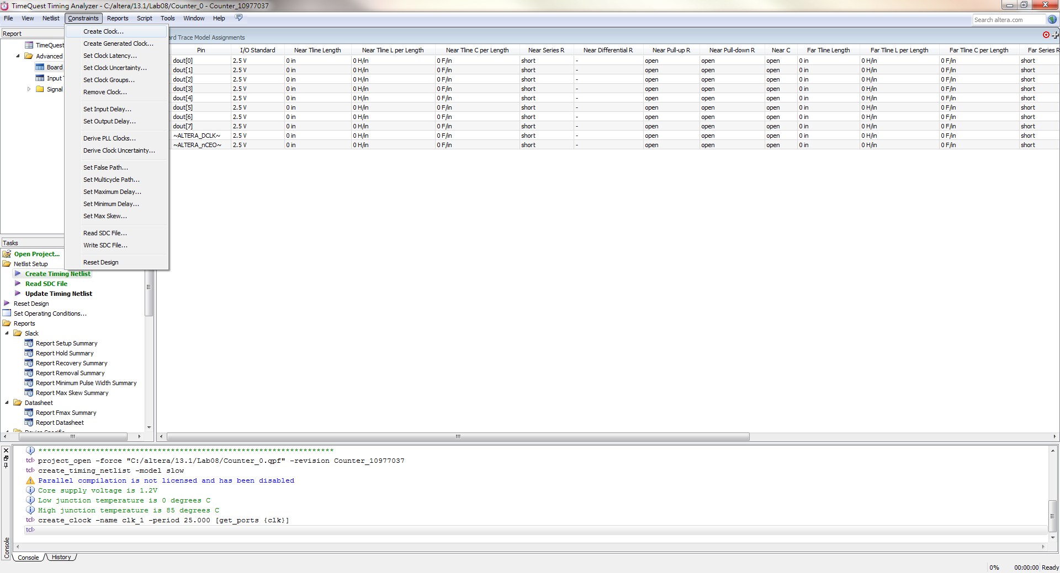
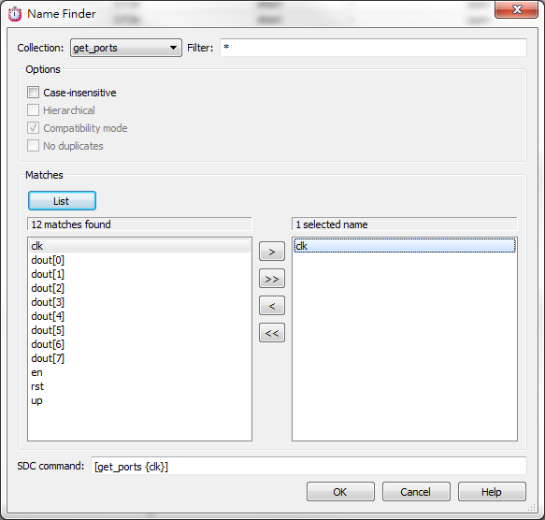
Constraints assignment [cont’d]
1
2
設定完後點選此item
3
4
5
check
create_clock -period 25.000 -name clk_1 [get_ports {clk}]

Slide 23

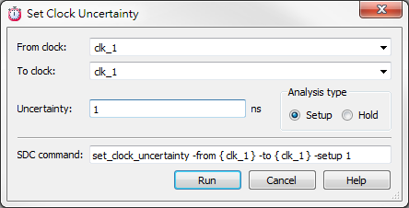
Constraints assignment [cont’d]
Setup設定完後，可點選hold再做同樣的設定

Slide 24
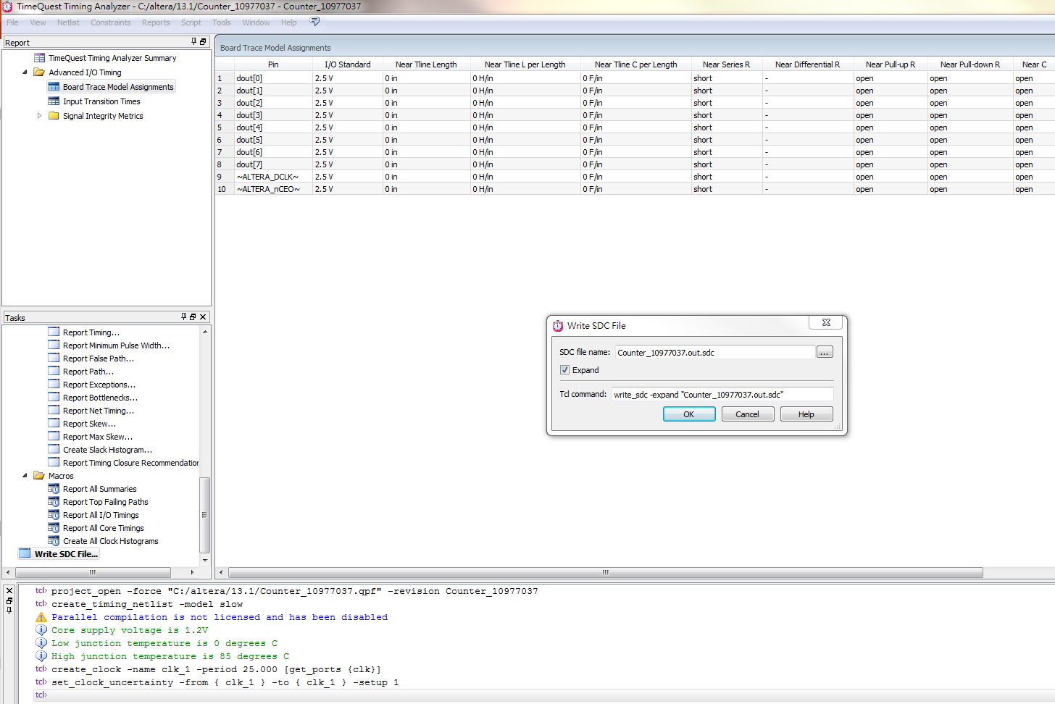
Constraints assignment [cont’d]
記得點選此item! SDC檔才能真正建立好

Slide 25
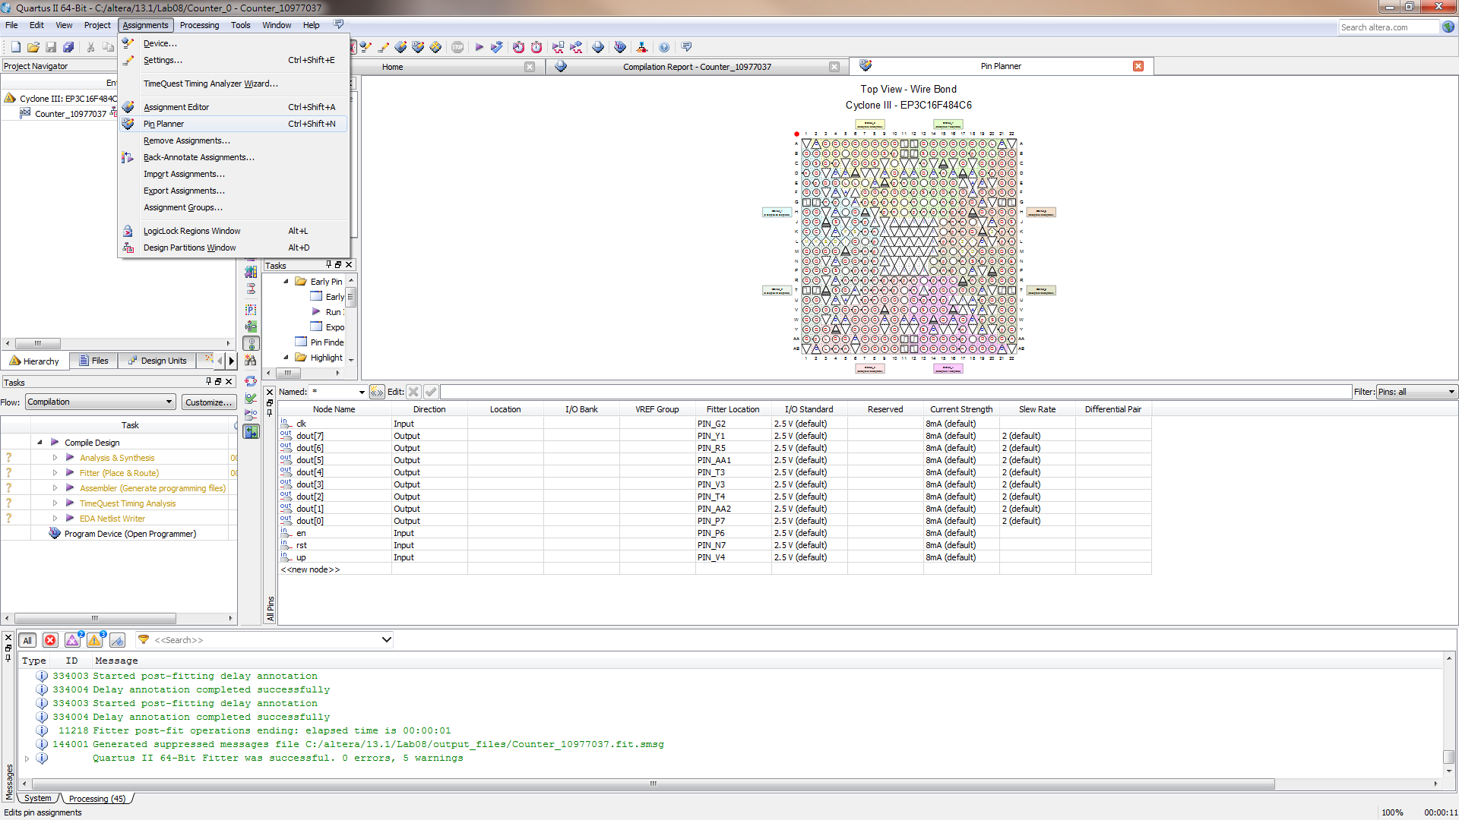
Pins assignment

Slide 26
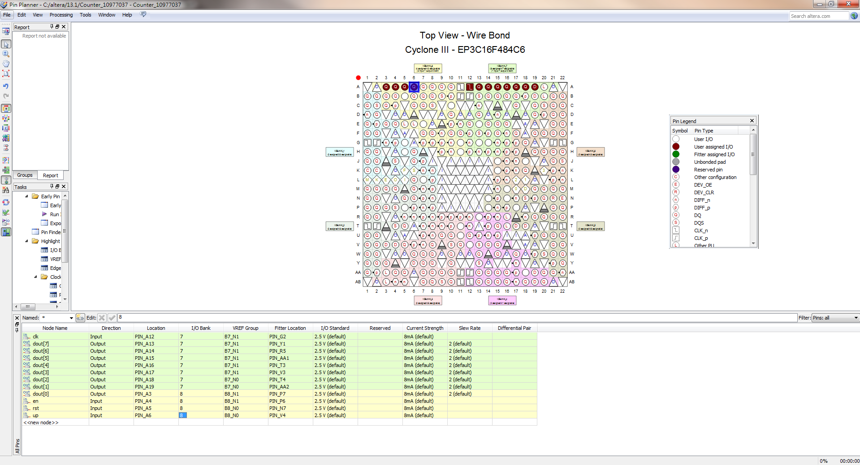
Pins assignment [cont’d]
截圖3!
一開始只有Pin的名稱(Node Name)，
但預設接腳(e.g., Location, …為空白
2. 在此Lab中，同學們可以隨意指定接腳
3. 如果此接腳設定欄表未出現，請參考
i-learning上” Pin_Planner顯示問題”所列解法。
(若還是解不了，就直接截圖吧)

Slide 27
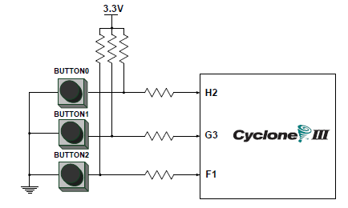
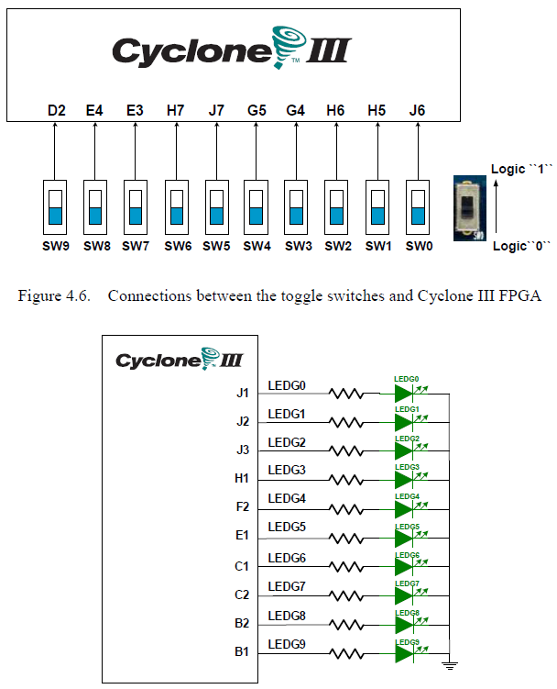
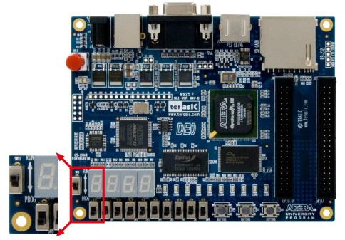
Define Input/Output Pins

Slide 28
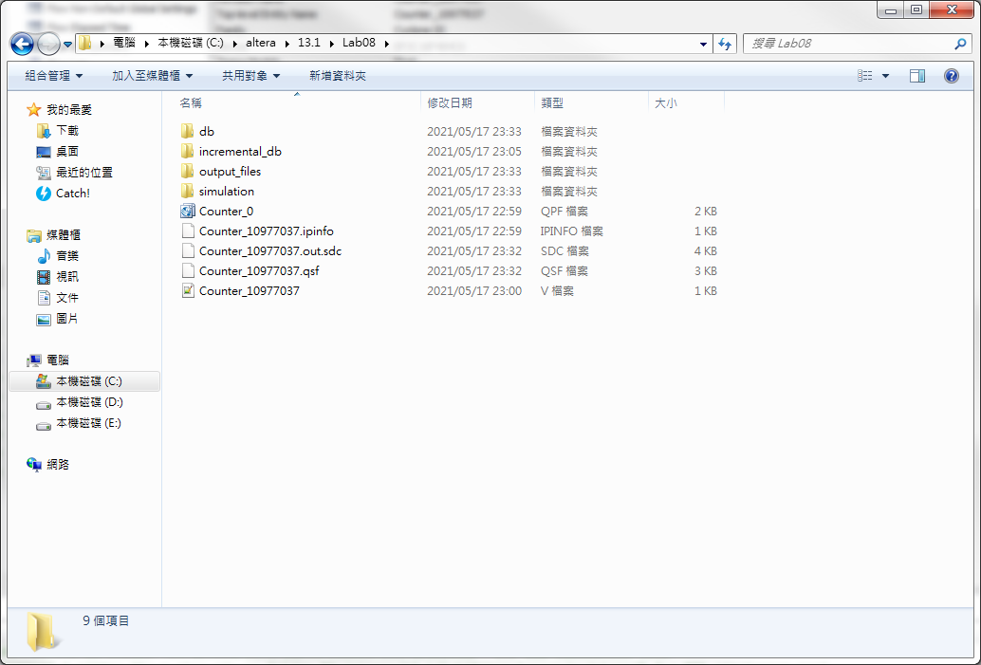
User Constrain File
請到Project的工作目錄中找到剛剛設定的
Constrain File (xxx.sdc) (參考p.p. 5-24)

Slide 29
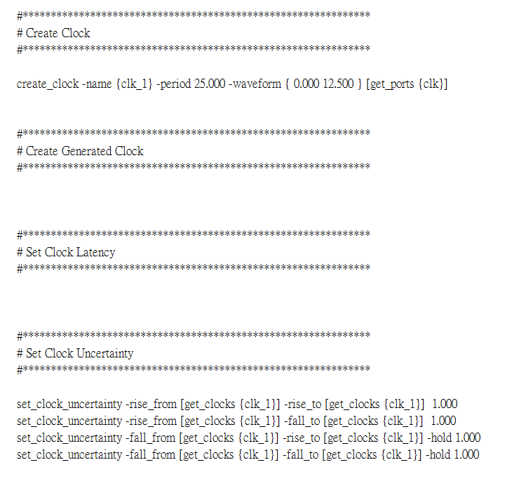
User Constrain File (xxx.SDC)
附件 !
(上傳)

Slide 30
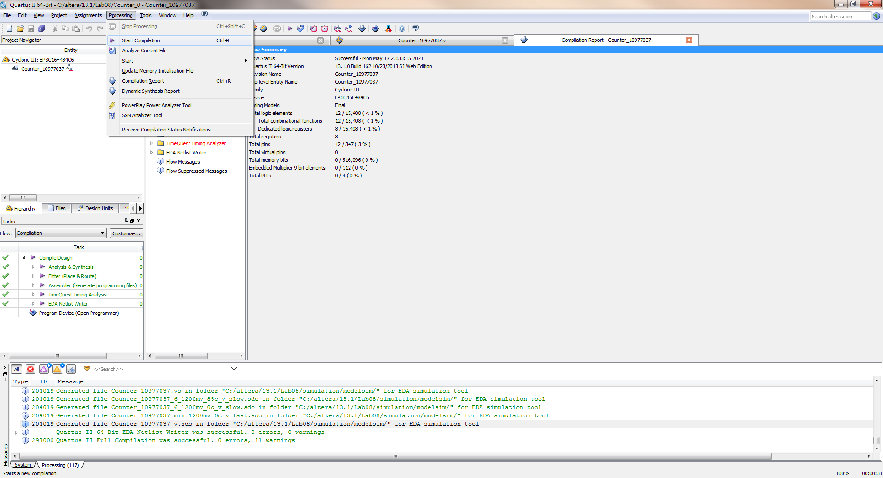
Start Compilation

Slide 31
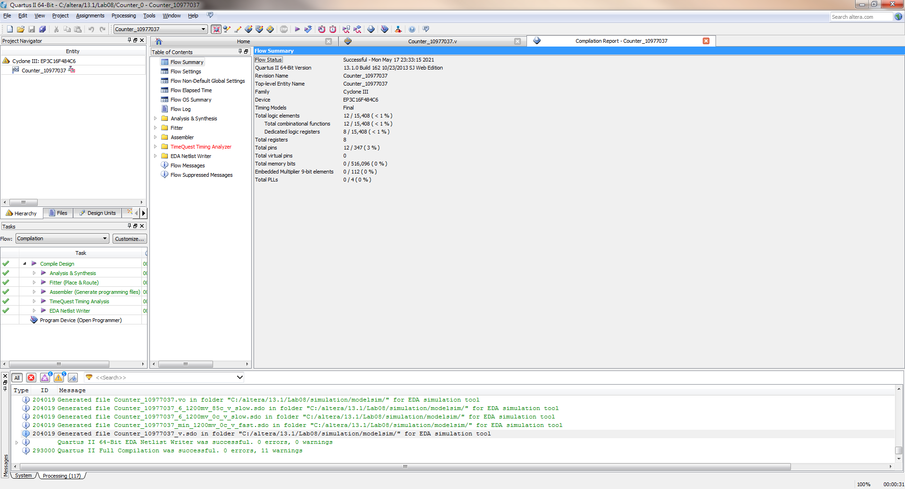
Start Compilation
截圖4!

Slide 32
報告說明
報告繳交: 5/3(三)11:59pm前 (兩週)
Design RTL code (.v)
Find device type
Use Quartus-II tools
Synthesize
Implement Design
Constraint assignment
Pin assignment
Generate bit-stream
Configure Target Device
Use ModelSim-Altera
Post-Simulation
五個items: (70%)
(每組交一份，分數以各組為單位)
四個截圖與一個檔案(SDC檔)
>> 少一個item扣10分
四個截圖可直接貼在word檔，與SDC檔一起上傳i-learning作業區。
(共有一個word檔與一個SDC檔，
請不要分別上傳圖檔!)
注意project名稱: Counter_組別或Counter_學號，若不相符扣20分。
課堂出席(4/20) : (30%)
>> 本週Lab如有問題，下週也可提問。

